Slide 1


Cloud Bites
AWS-Based Restaurant Ordering System
Major Project
Faculty Guide
Team Members: Arpit Gupta & Aditya Shukla
Anmol Singh

Slide 2

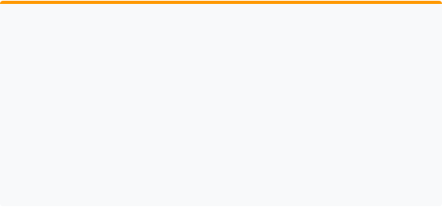

Problem Statement
The Challenges
The Solution: Cloud Bites
•
Manual order management & paper records
•
Slow processing & high human error risk
A modern, AWS-powered cloud infrastructure that automates ordering, streamlines admin tasks, and provides a scalable, secure database architecture.
•
Difficult menu & inventory management
•
Lack of centralized customer data

Slide 3

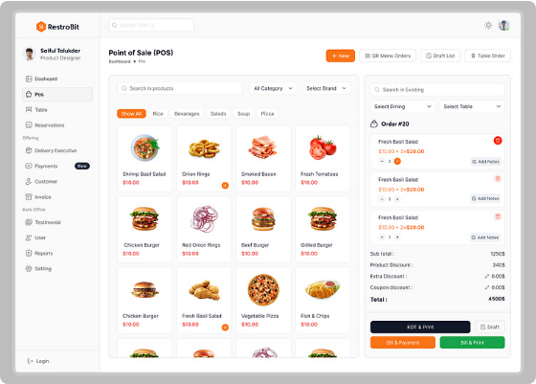
Project Overview
Deployed on AWS
Cloud Bites is a full-stack web application designed for high availability and performance.
Customer Side
Admin Side
Register, Search Food, Cart Management, Order Tracking.
Menu Control, Dashboard Analytics, Order Status Updates.

Slide 4
Technology Stack
Component | Technology Used | Brief Description
Frontend | HTML, CSS, Bootstrap, JS | Responsive UI with modern, clean layouts.
Backend | PHP | Server-side scripting for logic and DB connection.
Server | Apache | High-performance web server hosted on EC2.
Database | MySQL | Relational data storage managed via Amazon RDS.
Cloud Platform | Amazon Web Services (AWS) | Scalable cloud infrastructure & networking.

Slide 5

Core AWS Infrastructure
Amazon EC2
Amazon RDS
Amazon VPC
Hosts the Apache Web Server and PHP application files. Provides reliable compute capacity.
Managed MySQL database storing users, menu, and orders. Offloads DB administration.
Logically isolated virtual network. Houses EC2 and RDS for secure communication.
Security Groups
Internet Gateway
Public IP
Virtual firewalls controlling traffic. Allowed Ports: 22 (SSH), 80 (HTTP), 3306 (MySQL).
Bridge between VPC and the public internet, enabling users to access the application.
Unique identifier used to access the application directly via the browser.

Slide 6
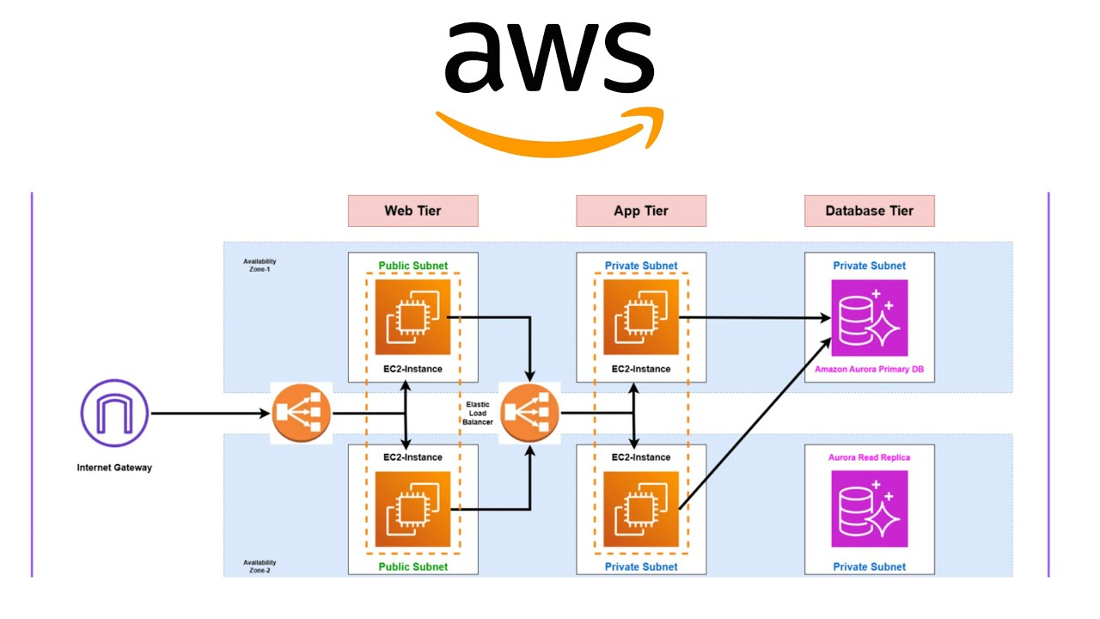

AWS Architecture Diagram
Add Architecture Diagram Here
Flow: Customer → Internet Gateway → EC2 (Ubuntu/Apache/PHP) → RDS (MySQL Database)

Slide 7



Database Design & Relationships
USERS
user_id (PK) full_name email role
ORDERS
order_id (PK) user_id (FK) total_amount order_status
MENU_ITEMS
ORDER_ITEMS
CATEGORIES
item_id (PK) cat_id (FK) item_name price
oi_id (PK) order_id (FK) item_id (FK) qty
cat_id (PK) cat_name
Note: ORDER_ITEMS acts as a junction table connecting multiple items to a single order.

Slide 8
Project Implementation Steps
AWS Account
Launch EC2
Security Groups
Install Apache/PHP
Config RDS DB
Upload Code
Module Testing
Live Deploy
Deployment Flow: Instance Setup → Environment Provisioning → Database Linking → Application Upload → System Integration Testing.

Slide 9
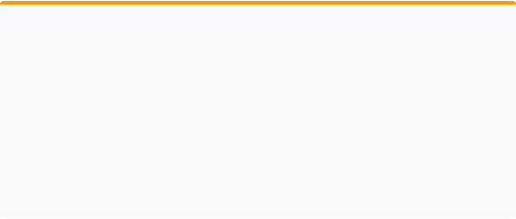
System Features
Customer Module
Admin Module
•
Secure Registration & Login
•
Centralized Dashboard
•
Search Bar & Category Browsing
•
Manage Menu & Upload Food Images
•
Dynamic Add to Cart
•
Real-time Order Management
•
Order History Tracking
•
Update Order Status (Preparing/Sent)
•
Responsive Web Interface
•
Customer Record Management

Slide 10

Future Scope (Roadmap)
AWS Route 53
AWS ACM & S3
ELB & Auto Scaling
Implement custom domain mapping (e.g., cloudbites.com).
SSL Certificates for HTTPS and S3 for static image storage.
Distribute traffic across instances and scale based on load.
CloudWatch & SNS
Payment Gateway
Mobile App
Resource monitoring and SMS/Email order alerts.
Integration with UPI, Stripe, or PayPal for live transactions.
Native Android and iOS applications using AWS Amplify.

Slide 11

Results
100%
Key Achievements
•
Successful integration of EC2 and RDS
•
Role-based Access Control (Admin/Customer)
•
Efficient dynamic menu search logic
AWS Deployed
•
Secure environment via Security Groups

Slide 12

Conclusion
Cloud Bites successfully demonstrates how AWS services like EC2, RDS, and VPC work together to create a secure, scalable, and efficient restaurant infrastructure.
Thank You
Questions?

